Slide 1
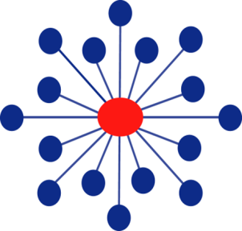

Welcome to CTN Mid-Atlantic Node/CEATTC Webinar Series
Using Motivational Incentives in Behavioral Health Treatment
Clinical Trials Network

Slide 2
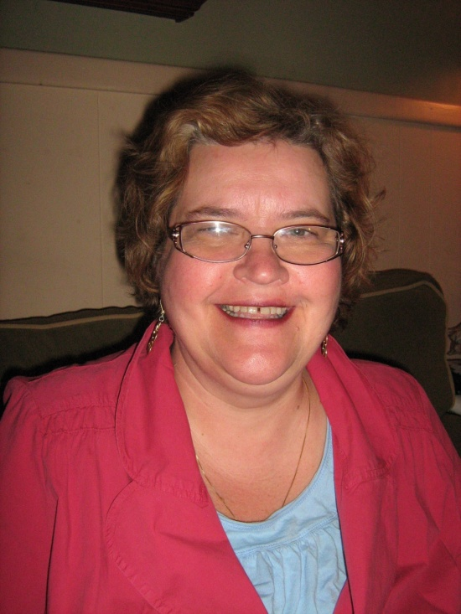
This is me!
Christine Higgins, M.A.
Dissemination Specialist, Mid Atlantic Node,
Clinical Trials Network/NIDA
PAMI Trainer
MI-Presto Trainer
Provide consultation on implementation

Slide 3
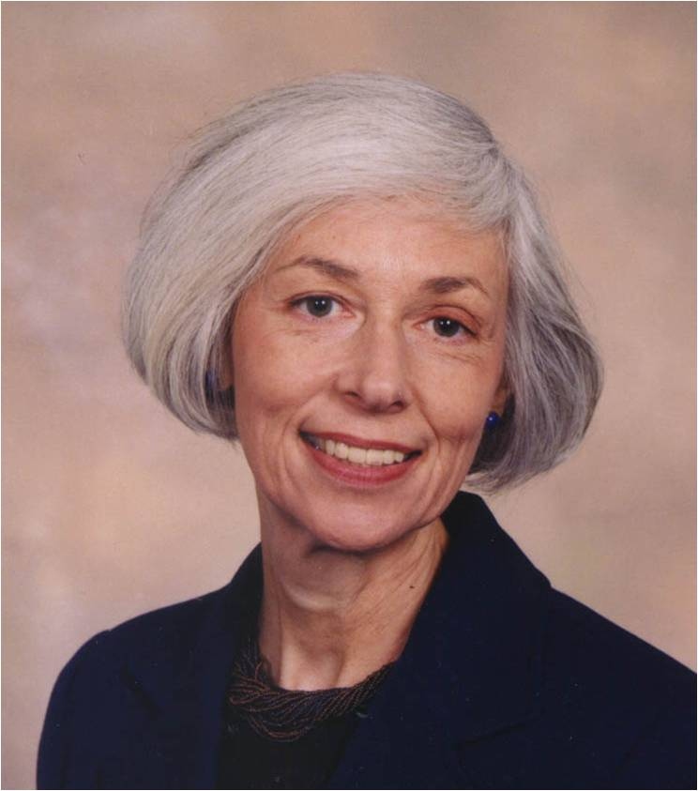
This is my boss and mentor!
Maxine Stitzer, Ph.D.
Principal Investigator
CTN Mid-Atlantic Node
Lead Investigator on the first national multi-site trial of abstinence incentives’ effectiveness when implemented in community drug treatment programs.
A recongized leader, well known for her seminal work on contingency management approaches in substance abuse treatment
MIEDAR STUDY CTN Protocol 006 & 007
ctndisseminationlibraary.org
Notes:
Motivational Incentives to Enhance Drug Abuse Recovery –talk much more about this in session #3

Slide 4
And you are!

Slide 5
Let’s begin with 2 survey questions:
Question #1:
I am currently working in a program that delivers incentives as part of treatment. Y/N
Question #2:
I have first-hand experience with implementing incentives where people received prizes. Y/N

Slide 6
Session 1
Introduction to Incentives
What we will cover today:
What is contingency management?
Why are incentives such a powerful tool?
What is a reinforcer? How is it different from a reward?
How do I target a behavior?
How do I target a population?
How do I choose a reinforcer?

Slide 7

Contingency
Question #3: Who would like to share with us the definition of contingency?

Slide 8
Why are they such a powerful tool?
BF Skinner’s work and Operant Conditioning: positive and negative reinforcers
What are some of the negatives that we know the people we serve have experienced:
fines, violations, sanctions, rejection from family, job loss, illness, hospitalization, incarceration, and more
“Been down so long, it’s beginning to look like up.”

Slide 9

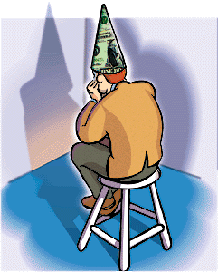
or

Slide 10
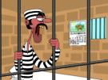

or

Slide 11

Reward vs. Reinforcement
A central issue in all incentive dissemination efforts
When staff or leadership speak about the use of incentives, they usually talk about acknowledging patients for things like:
  Holding a job for six months
  Being drug-free for 3 months
  Completing a GED or vocational
  training program

Slide 12
Reward Programs
This is what Scott Kellogg calls a Reward Program:
“Acknowledging patients for achieving a goal or accomplishing something noteworthy
  Most likely give rewards to the best and most motivated patients
  While often not changing the behavior of those patients who are struggling the most with drug use and treatment compliance”
Notes:
Scott Kellogg, NYU

Slide 13

Proximal vs. Distal
Reward= Individual or group prizes for achieving a particular goal
Incentive=a reinforcer to motivate or propel forward an individual or group to help achieve a particular goal.
It’s not only what you give,
but when you give it.
Notes:
Think about the 30 days sober medallion in A.A. Is that a reward or a reinforcer?

Slide 14
Creating INCENTIVE Programs
You learn to move from “Good job! To “Good for you!”
“You have taken a step in the right direction”
This is the most important change that begins
to counter constant negative consequences.
Notes:
MI offer an affirmation it is very specific.

Slide 15
Reinforcement Programs
Reinforcement Program
  Breaks down each of the goals into very small steps
  Reinforces each of the steps along the way
  It’s easier to earn
  Distributes positive reinforcements with
  fairly high frequency

Slide 16
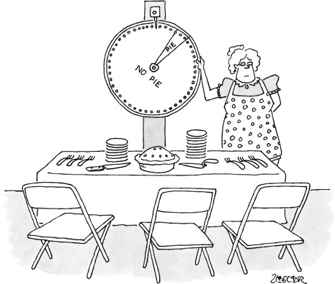
…chance of winning needs to be reasonably attractive

Slide 17
Remember:
It’s the CONTINGENCY
that matters……….
BEHAVIOR
REWARD*
Giving things away for free
does NOT change behavior

Slide 18
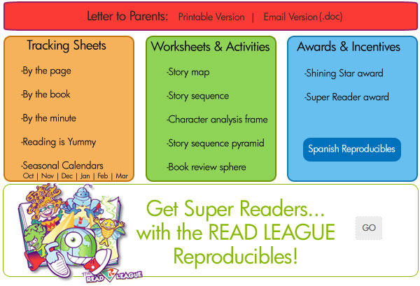
Used in so many arenas:
Notes:
Not just school, Health incentives, consumer incentives (loyal customers), immunizations—gives that extra push

Slide 19

Drug User’s Dilemma
CONTINUED USE
SOBER
LIVING
Get a job
Time with family
Better health
These goals may seem far off in early treatment!
Easy money
Hang with friends
Get high

Slide 20

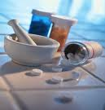
Contingency Management: Application in Drug Abuse
Measurable target behavior
Rewarding consequence

Slide 21
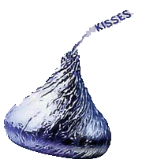
Patients like them!
Broadly applicable across target behaviors
An intervention to add to the counseling tool box.
Promotes self-esteem, increases self-efficacy

Slide 22
Look at the cultural shift!
Promoting Awareness of Motivational Incentives (PAMI)
www.bettertxoutcomes.org (1:17 – 2:37)

Slide 23
Quiz Question:
Are incentives designed for:
a.) compliant patients
b.) non-compliant patients
c.) both

Slide 24
Quiz Question:
If in a meeting, a colleague says:
“Let’s not give recovery bracelets to the new people because we don’t even know if they’ll hang around. Let’s say you have to complete 30 days. Would you agree or disagree with this incentive plan?”
Notes:
Trick question

Slide 25
7 Principles of Motivational Incentives:
Target Behavior
Choice of Target Population
Choice of Reinforcer
Incentive Magnitude
Frequency of Incentive Distribution
Timing of the Incentive
Duration of the Intervention

Slide 26
Target Behavior
Something that is problematic and in need of change.
What’s broke and needs fixin’?
What keeps the Director up at night?
Where do your best efforts seem wasted?
Handout: Improving the Balance Sheet
Notes:
Handout

Slide 27
Target Behavior
The “reinforcement” model emphasizes
breaking the goal down into very small steps
and then reinforcing each of the steps as they occur.
The behavior must be observable and measurable.
Choosing a target behavior involves something problematic or in need of a change. Then, the new behavior becomes a contingency.
Notes:
Discuss how 5 weekly gift card becomes attend 4 weeks in a row to receive gift card. Shifts from proximal to distal.

Slide 28
Advantage of attendance incentives
Easy to monitor
Enhance client engagement
Ensure delivery of important counseling elements
May increase clinic revenue

Slide 29
Target Population
Population?
What’s broke and needs fixin?
-Whole clinic
-Unemployed
-Males/Females
-Court ordered
-Late payers
-Parolees
-Co-occurring disorder pts
Poor attendance in group
High unpaid fee balances
Low response to special classes
Low employee morale
Overcrowded waiting room
High incidence of diabetes
Loitering/disturbances
High incidence of cocaine use
No-shows for doctor appts

Slide 30
Example: IBR Reach/Methadone
Maintenance Clinic
Target Population:
Poor attendance at
Orientation Groups
which are required at the beginning of treatment and mandatory for a first take-home.
Target Behavior:
Attend all 4 groups, win a prize and a raffle ticket in each group, enter to be part of a monthly raffle. Double your tickets if you complete all 4 groups in 30 days.

Slide 31

REACH 4 IT!
Attend Orientation Groups and
Win Prizes!$!$!$!!
Starting March 20th!
Earn a GRAND PRIZE raffle ticket each time you attend.
Attend all 4 groups in 30 days and double your chances to win.
Open to everyone!

Slide 32
Giveaways
Intro to R.E.A.C.H.—Pens
Disease of Addiction –Bracelets
Medicine—Water Bottles
HIV/AIDS—Gift bag w/condoms (male &
female), candy, mints.
Purchased with a stationery line item in the budget. Patients get a raffle ticket and receive one giveaway each time they attend.

Slide 33
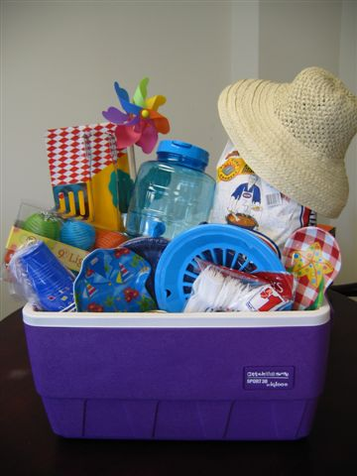
Grand Prize Raffle
Counselors filled a cooler filled with dollar store picnic items which was on display in the lobby.
Notes:
Very nice design

Slide 34
Choice of Target Population
“While it might be ideal to provide reinforcements for all patients in a program, this may not be feasible or even necessary.”
Issues of “fairness” may come up…

Slide 35
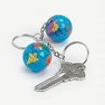
Example: Man Alive
Methadone Maintenance Clinic
Target Behavior: Keep your insurance current
Target Population: Managed Care Patients
Reinforcer/Incentive: $5 and $10 gift cards to CVS, Dunkin’ Donuts and Safeway
Contingency: Bring your DSS letter in for review/receive a $5 gift card; show proof of keeping your re-con appt. receive a $10 gift card.
Delivery: immediate
Alternate for Paying Patients:
“We think the world of you for keeping
your insurance current.”
Notes:
Who didn’t like it? The patients who kept their insurance current.
What was the benefit for the agency? Insurance kept current means ensurance of payment.

Slide 36
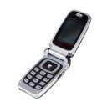
Choice of Reinforcer
Higher magnitude reinforcers engender greater abstinence (Silverman et al, 1999; Stitzer et al., 1984).
Make sure your reinforcer is adequate enough to compete with reinforcement derived from target behavior.
Look for reinforcers of “high magnitude”
but not high cost.
Always ask the patients what they like.
Dunkin Donuts , KFC or 7-11?

Slide 37
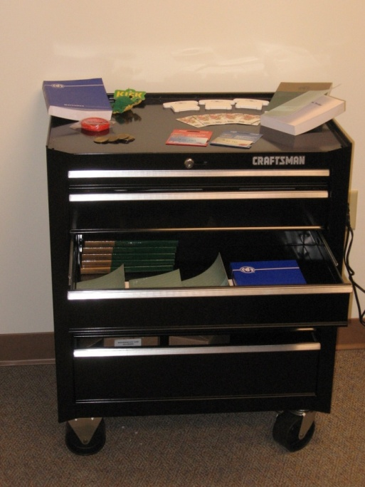
Reinforcers
Gift cards, vouchers, bus tokens,
privileges, reduction in fees,
positive report to P.O. or judge,
lessened reporting.
Jim Bieting’s Recovery Cart– filled with small prizes and 12 Step materials. Locked, rolling cart from
Craftsman Tools.
Notes:
You tell me…what might be a good reinforcer

Slide 38
Melissa talking about prizes:
http://www.danyainstitute.org/2012/10/danya-institutes-video-library-on-youtube/

Slide 39
Escalating system and bonuses
The escalating and bonus system engenders continuous abstinence (Roll, Higgins, & Badger, 1996).
Use bonuses for one week, one month, etc.

Slide 40
With each of these efforts, what are we after?
Time!
Give probationers time to internalize
the sense of moving forward and
to develop naturally re-occuring
reinforcers.

Slide 41
A Word About Attitude
Notes:
It’s all in how you do it.

Slide 42
Counselors Come to Understand Reinforcement
“We came to see that we need to reward people where rewards (reinforcers) in their lives were few and far between
We use the rewards (reinforcers) as a clinical tool – not as bribery, but for recognition
The really profound rewards will come later”
42
Notes:
42

Slide 43
Contributes to Positive
Clinician-Client Interaction
When patients publicly, and sometimes tearfully, acknowledged the counselor’s help in public, the staff felt a sense of gratitude
“In the last two award ceremonies, clients said, ‘I want to thank the staff….’ That sounded real good – we felt appreciated”
43
Notes:
43

Slide 44
Let’s take a look around:
www.motivationalincentives.org

Slide 45
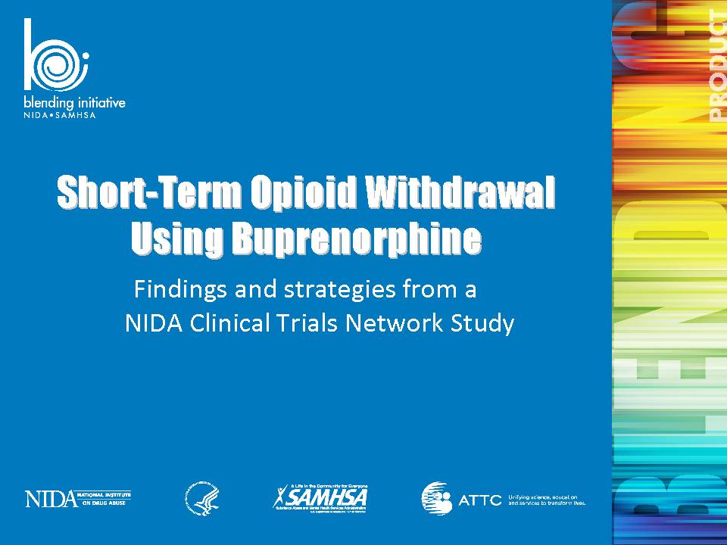

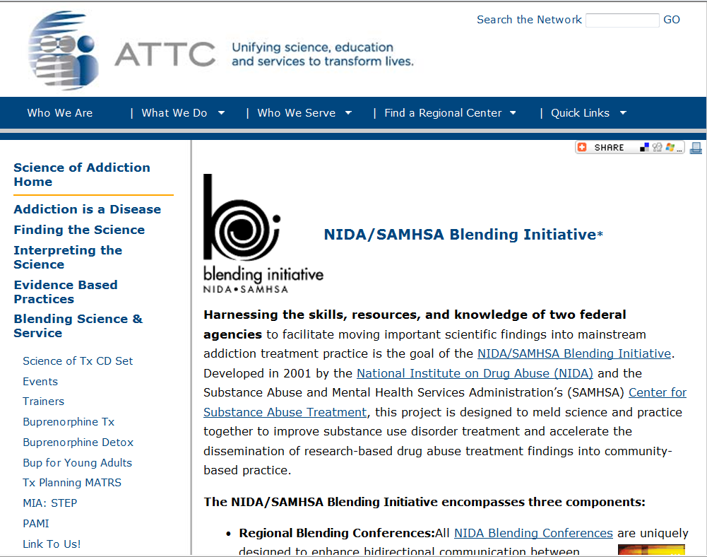
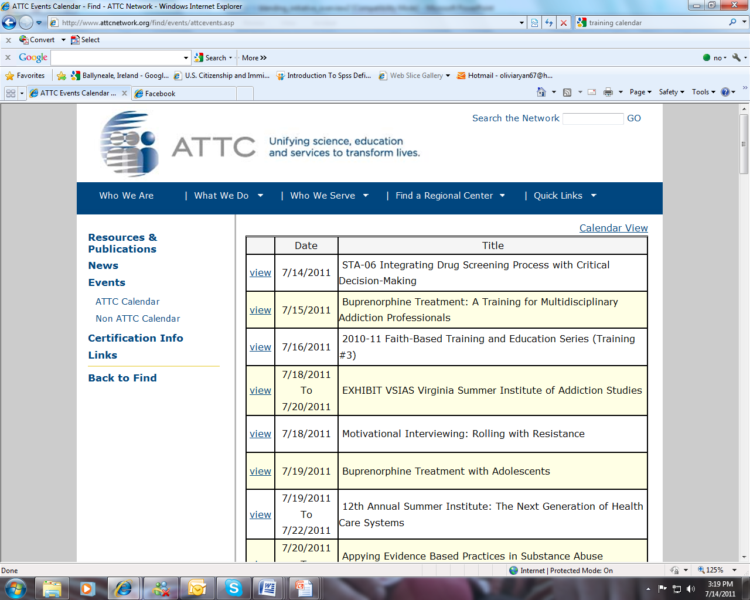
Product
Dissemination
Download the Products for FREE!
Find upcoming trainings offered through SAMHSA’s ATTC Network!
Go to http://www.attcnetwork.org/blendinginitiative

