Slide 1


Welcome to
CTN Mid-Atlantic Node/
Central East ATTC Webinar Series
Using Motivational Incentives in Behavioral Health Treatment
April 24, 2013
Vouchers and Fishbowls
Clinical Trials Network

Slide 2
Facilitator:
Christine Higgins, M.A.
Dissemination Specialist, Mid Atlantic Node,
Clinical Trials Network/NIDA
PAMI Trainer
MI-Presto Trainer
Provide consultation to many Community Treatment Programs on implementation
Notes:
Most of them have been substance abuse treatment programs, but I think you will find that these will apply to those with co-occurring disorders, mental health issues, chronic health issues, and for other behaviors.
2

Slide 3
And our attendees today are a mix of
professionals, including…
nurses, case managers, and social workers…
from the fields of mental health, addictions, criminal justice and medicine.
Notes:
A word about application of incentives for criminal justice, mental health, nurses, case managers, health depts., etc.
3

Slide 4

Let’s begin with 2 survey questions:
Question #1:
I attended at least one of the last two webinars. Y/N
Question #2:
I have first-hand experience with implementing incentives where people received tokens or prizes. Y/N
Notes:
Getting Your Feet Wet (website)
4

Slide 5

A quick review of Session 1 & 2:
We have discussed the principal of contingency management or motivational incentives (interchangeable terms) in which there is some observable and measurable behavior that is reinforced each time it occurs, and it is often one step in a series of steps that leads to achieving a larger goal.
Notes:
So rather than rewarding a patient for total abstinence, we reinforce one negative urine for one particular drug.
5

Slide 6

Last week, we talked about the option of a
tic-tac-toe board to break large goals
(like achieving a methadone take home)
down into smaller steps and reinforcing
each step along the way.
We also discussed how these small steps can be reinforced using smaller no-cost or low cost prizes while still acknowledging achievement.

Slide 7
First Tic-Tac-Toe
Prize from the treasure chest.
Second TicTac Toe
Inspirational
Poster
Fill the board:
Earn your first take home:
_____________
Counselor’s
Signature
____________
Date of Completion
Good Sam's Methadone Clinic
Tic Tac Toe Take Home
Regular
Attendance
Orientation
Session 2
Orientation
Orientation Session 1
First
Meeting
Regular
Medication
Fee
Approval
Orientation
Session 4
2nd contact group or
ind.
Orientation
Session 3
Patient’s Name _______________________

Slide 8

Staying on Track
Probation Tic Tac Toe
First Tic-Tac-Toe
Prize from the treasure chest.
Second TicTac Toe
Appointment
Book
Fill the board:
Certificate of Completion
_____________
P.O.
Signature
____________
Date of Completion
Complete
Job Skills Class
Orientation
Fee payment
2nd Appt.
Report to
Agent
Long
Term goal
Network list/ support people
Visit
Workforce
Development
Give urinalysis
Contacts from
job search
Probationer’s Name _______________________

Slide 9
Tic Tac Toe Versus Other Methods
The Tic Tac Toe method was developed by practitioners and is compatible for use with individual treatment plan goals
  Primary and mental health care; probation requirements, educational or vocational attainment
Standard reinforcement methods using vouchers or fishbowls have been used for basic treatment goals of attendance and drug abstinence

Slide 10
Session #3
Voucher and Fishbowl Method
What we will cover today:
What is a voucher system?
What is the fishbowl method?
How well do they work in research studies?
Why do we choose one method over another?
How do we pre-determine the cost?

Slide 11
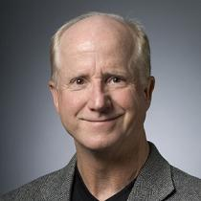
Voucher Reinforcement
Dr. Steven Higgins invented the voucher reinforcement method in the early 1990’s. Research has shown over and over that vouchers are highly effective in reducing drug use and retaining cocaine abusers in treatment programs.
Amount offered in original research was $1000 during a 12-week treatment episode

Slide 12

$1000???
Yippee!!!
You’ve got to
be kidding!!!

Slide 13
Voucher Reinforcement
Elegantly incorporates behavioral principles to initiate & sustain abstinence
• Demonstrated efficacy in controlled trials
BUT
Costs were high ($1000 offered per client)

Slide 14
Cost May Be Worthwhile
The economic cost to U.S. society of drug abuse?
Nearly 100 billion dollars, according to the National Institute on Drug Abuse.
Use of drugs like cocaine is associated with serious social and health problems, including crime and the spread of infectious diseases.
If motivational incentives help people stay in treatment longer, and people have a better chance of long term recovery, it may be worth it.

Slide 15

Innovative Cost Reduction Approaches
Dr. Ken Silverman and colleagues at Johns Hopkins University formed a non-profit data processing company to employ and treat drug addicts.
Hopkins Data Services, employed men and women who abused cocaine and gave them regular salaries (instead of vouchers) for their data entry work as long as they stayed off drugs.
The company's goal was to maintain a self-sustaining business that could employ the former addicts and pay for their drug treatment and monitoring.

Slide 16

Innovative Cost
Reduction Approaches
Psychologist Nancy Petry at the University of Connecticut finds that a lower-cost reward system using prizes also works in retention and treatment of drug abusers and may be attractive to community-based treatment programs that cannot afford using the vouchers.
The Fishbowl Method: Intermittent Reinforcement Schedule is used in the first multi-site trial of abstinence incentives in community drug settings.

Slide 17
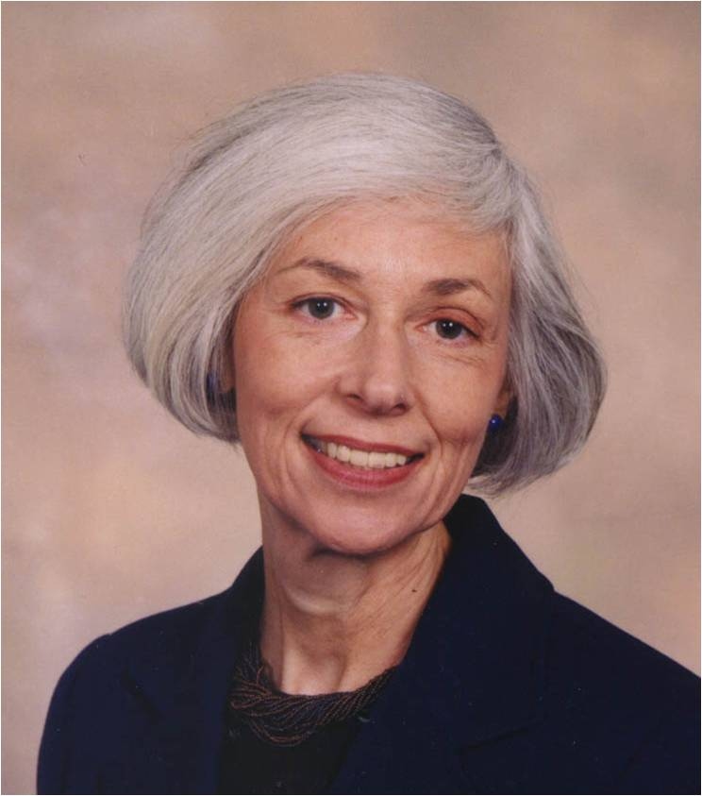
This is our guest today!
CM expert and lead Investigator of the national CTN multi-site study of abstinence incentives
MIEDAR: Motivational Incentives to Enhance Drug Abuse Recovery
Dr. Maxine Stitzer,
Principal Investigator,
CTN Mid-Atlantic Node
MIEDAR STUDY CTN Protocol 006 & 007
ctndisseminationlibrary.org
Notes:
Motivational Incentives to Enhance Drug Abuse Recovery –talk much more about this in session #3
17

Slide 18
How do motivational incentives fit into the clinical picture?
Add-on to counseling as usual
  Special intervention to enhance motivation for sustained abstinence
  Focuses on the positive to recognize and celebrate success
  Allows counselors to work on life-style changes that can sustain abstinence beyond incentives

Slide 19
Voucher Reinforcement making abstinence a more attractive option using a point system
Intensive counseling plus abstinence incentives
Points earned for cocaine negative urine results
  Escalating schedule with reset penalty
  Trade in points for goods
  $1000 available in first 3 months

Slide 20

Points Escalate with
Stimulant-Free Test Results
5
4
3
# points
2
1
Weeks Drug Free

Slide 21
Bonus Points Can Be Awarded for
Opiate and Marijuana Abstinence
2
2
2
2
2
# points
Weeks Drug Free

Slide 22
Voucher Trade-in
Clients could trade in points at any time and request any retail items they might want
  Some spent frequently;
  Some saved up for larger items
Staff would go shopping to fill client requests

Slide 23
Why $1000?

Slide 24
Voucher Incentives for Outpatient
Drug-free Treatment of Cocaine Abusers
Higgins et al. Am. J. Psychiatry, 1993
Cocaine negative urines

Slide 25
Higgins Studies With On-site VS Off-site Control Groups
Percent of Participants
Consecutive Weeks of Abstinence

Slide 26
CTN MIEDAR Study
Participants = 800 stimulant users (cocaine or methamphetamine)
Two parallel studies conducted:
6 methadone and
8 drug-free programs

Slide 27
Random Assignment
• Usual care
• Usual care enhanced with
abstinence incentives
3-month evaluation

Slide 28
Fishbowl Method
Incentive = draws from a bowl
- Draws earned for each stimulant-negative urine with negative BAC
Draws escalate with consecutive negatives
Bonus draws given for also being opiate
and marijuana negative

Slide 29

Intermittent Reinforcement Schedule:
Draws from the Abstinence Bowl
Good
Job
Small
Jumbo
Good
Job
Large
Small
Small
Large
Small
Good
Job
Good
Job
Good
Job
Good
Job
Good
Job
Good
Job
Small
Good
Job

Slide 30


Slide 31

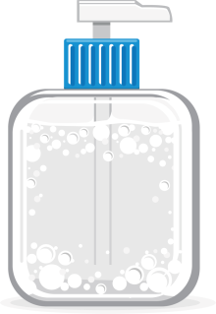
Half the chips were winners
Win frequency inversely related to cost
largest chance (42%) of winning a small $1 prize
moderate chance (8%) of winning a large $20 prize
small chance of winning a jumbo $100 prize

Slide 32

Sample Collection
Twice Weekly Over
12 Weeks

Slide 33

Total Earnings
$400 in prizes could be earned on average
  If participant tested negative for all targeted drugs over 12 consecutive weeks

Slide 34
On-site Prizes

Slide 35
MIEDAR: Who participated and how did it turn out?
Retention and Drug Use Outcomes

Slide 36
METHADONE PROGRAM STUDY RESULTS

Slide 37
Study Retention in Methadone Treatment
100
80
Percentage Retained
60
Incentive
40
Control
20
RH = 1.1
CI = 0.8,1.6
0
2
4
6
8
10
12

Slide 38
Percent Stimulant Negative Urines
1
0
0
A
b
s
t
i
n
e
n
c
e
I
n
c
e
n
t
i
v
e
8
0
U
s
u
a
l
C
a
r
e
6
0
Percentage of stimulant negative
urine samples
4
0
2
0
OR=1.91 (1.4-2.6)
0
1
3
5
7
9
1
1
1
3
1
5
1
7
1
9
2
1
2
3
S
t
u
d
y
V
i
s
i
t

Slide 39
Individual Subject Performance
21% Incentive
vs
8% control
had prolonged abstinence outcome
(19-24 Stimulant Negative Urines)

Slide 40
Outpatient Psychosocial Clinics: Contrasting Outcomes

Slide 41
Percent of Submitted Samples Testing Stimulant and Alcohol Negative
100
80
Percentage negative samples
60
40
Abstinence Incentive
Usual Care
20
0
1
3
5
7
9
11
13
15
17
19
21
23
Study Visit

Slide 42
Incentives Improve Retention in Counseling Treatment
100
Incentive
Control
80
60
50%
Percentage Retained
40
35%
20
RH = 1.6 CI=1.2,2.0
0
2
4
6
8
10
12
Study Week

Slide 43
Psychosocial Site Differences: Raising Performance
Abstinence incentives worked best in clinics with lower retention
  Control mean = 3.6 - 6.8 weeks
Clinics where clients were usually retained for 8 weeks didn’t show improved retention with incentives

Slide 44
RESEARCH CONCLUSIONS
Incentives can improve client outcomes on retention and drug use when implemented in community treatment programs

Slide 45
How much was paid out in MIEDAR?
Psychosocial counseling study: $203
Methadone study: $120
Why was more $$$ paid out in the psychosocial counseling study?
  1) More subjects in study
  2) More counseling received
  3) More motivated patients
  4) Less stimulant drug use overall

Slide 46
Amount of Money Needed Depends On Target Behavior
Attendance
  Effective studies have offered $250 or less over 12 weeks
Drug abstinence
  Effective studies have offered $250 or more
Why?
  More difficult behavior change requires higher reinforcement values

Slide 47
Amount of Money Needed Depends on Problem Severity
Recent Petry study divided clients at intake into those testing pos vs neg for stimulant
For negative clients, goal is relapse prevention
  $250 was fine and less may have worked too
For positive clients, goal is stopping use
  $560 was effective but $250 was not

Slide 48
Harder the behavior change, more that is needed to motivate change

Slide 49
Same Incentives For All vs Individualized Approach
This is one of the first dilemmas faced in adopting an incentive approach to supplement usual care treatment
We recommend same for all while getting your feet wet in use of this technique
  Easier to learn and implement
  May be perceived as more “fair” by clients

Slide 50
Nitty Gritty of How To Do It

Slide 51
Designing A Voucher Program for Abstinence Incentives
Decide on maximum earnings per patient
  $400-$600 may be needed for active drug users
  Less will do for relapse prevention or other targets
Decide on frequency and duration of reinforcement occasions
  e.g. twice weekly for 12 weeks
Design escalating schedule of points
  Can have a “top-out” value e.g. 10 points per neg UA
Assign money value to numeric points to achieve desired maximum earnings

Slide 52
Total Points = 195
@ $1 each max cost = $195
@ $2 each max cost = $390
@ $5 each max cost = $975
Note that payout is usually
about 50% of max cost

Slide 53
Exercise
Devise a voucher point schedule for your clinic
Pick a target behavior:
1 = Attendance
2 = Abstinence

Slide 54
Exercise Examples
Twice Weekly OP
(4 week program)
Once Weekly UA
(6 week program)

Slide 55
Why did we assign more numeric points to the urinalysis program than to the attendance program?

Slide 56
Cost Calculations
4-week Attendance Program:
36 points
What is the total cost for:
$1 prizes
$2 prizes
$5 prizes
6-week Neg UA Program
90 points
What is the total cost for:
$1 prizes
$2 prizes
$5 prizes

Slide 57
Cost Calculations
4-week Attendance Program:
36 points
What is the total cost for:
$1 prizes = $ 36
$2 prizes = $ 72
$5 prizes = $180
6-week Neg UA Program:
90 points
What is the total cost for:
$1 prizes = $ 90
$2 prizes = $180
$5 prizes = $450
Which dollar amount would you pick?
Attendance Program UA Program
(Remember, you usually end up paying out about half
of what is offered)

Slide 58
Designing A Fishbowl Program
Find an opaque bowl and make tickets or chips
Decide on number of chips (500 has been standard but can be less)
Decide on frequency and duration of draw occasions
  e.g. twice weekly for 12 weeks
Design escalating schedule of draws
  Can have a “top-out” value e.g. 10 draws per neg UA
Decide on approx maximum earnings per patient
  $400-$600 may be needed for active drug users
  Less will do for relapse prevention or other targets

Slide 59
Total draws = 195

Slide 60
Designing A Fishbowl Program
Calculate total number of possible draws
Decide on prize categories and prize values
  e.g. small = $1, medium = $10, large = $30
Decide on percentage of chips for each prize value based on cost per draw calculation

Slide 61
Cost Per Draw Calculation
Total draws = 195
Half the chips (250) = “Good Job”
Half (250) result in prizes
Cost per draw = Probability of win X cost of prize
prize total
# chips prob cost Per draw cost # draws cost
_____________________________________________
200/500 = .40 X $1 = .40 per draw X 195 = $78
30/500 = .06 X $10 = .60 per draw X 195 = $117
20/500 = .04 X $30 = 1.20 per draw X 195 = $234
Total cost = $429

Slide 62
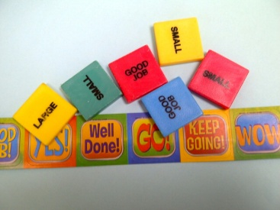
Nancy Petry’s Calculations for 1000 slips Fishbowl
Table 10.7 Formula for Adjusting Prize Bowls to Alter Costs
Note: Type in the gray sections. A sample is provided.
Slips | Type | Max value | Avg value | Proba- bability | Cost per draw
595 | Good Job | 0 | 0 | .0595 | $0.00
320 | Small | $1 | $0.80 | 0.32 | $0.26
60 | Medium | $5 | $4.00 | 0.06 | $0.24
24 | Large | $20 | $18 | 0.024 | $0.43
1 | Jumbo | $100 | $80 | 0.001 | $0.08
Total |  |  |  |  | Total
1000 |  |  |  | 1.00 | $1.01

Slide 63
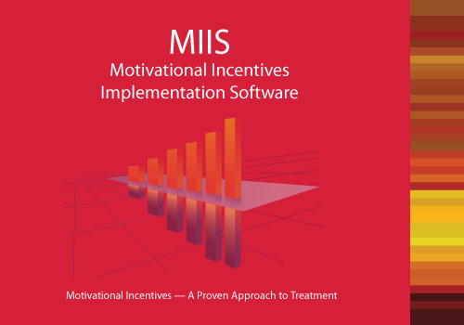
Designing a fishbowl takes thought..
Cost depends on value of prizes, percentage of
winning chips and number of draws. You can use a standard fishbowl draw of 500 (as we saw today), and, this software can help you keep track of inventory and
target behaviors.
It even has a
virtual
fishbowl!
Notes:
You are prompted to make the decisions you need to make..

Slide 64
Choosing Between Vouchers and Fishbowls
Cost is not the issue: Both can be adjusted to achieve desired total available payout
  Vouchers: monetary value and total possible number of points
  Fishbowl: cost of prizes offered; probability of winning each prize; total possible number of draws
Efficacy is not the issue:
  Research shows that both are effective with equivalent effects at similar costs

Slide 65
Why Choose One Over the Other?
Which would clients like best?
  Fishbowl allows participation
  Vouchers offer more certain payoffs
Which makes it easier for staff to manage?
  Tracking; fishbowl has MIIS
  Shopping could be done in bulk for either
  Fishbowl requires maintenance and cheat control

Slide 66
Which method do you prefer and why?
Choice 1: Voucher
Choice 2: Fishbowl

Slide 67
Dissemination/Adoption
Clearly recognized as one evidence-based practice advocated by program funders and licensers
1/4 - 1/3 of clinics are currently using incentives- mostly to reinforce attendance (Roman et al., 2010)
Information on what it is and how to do it increasingly available
  PAMI materials at www.nattc.org
- PAMI and MI:PRESTO at www.bettertxoutcomes.org (on-line course)

Slide 68

For more how-to information:
.
Contingency Management for Substance Abuse Treatment: A Guide to Implementing This Evidence-Based Practice by Nancy Petry
With charts, worksheets and tables!

Slide 69

Motivational Incentives Suite
1. Promoting Awareness of Motivational Incentives (PAMI)
2. Motivational Incentives: Positive Reinforcers to Enhance Successful Treatment Outcomes(MI:PRESTO)
For additional copies, contact:
Katia Delrahim-Howlett, Ph.D.
Synergy Enterprises, Inc.
8757 Georgia Avenue, Suite 1449
Silver Spring, MD 20910
240-485-1700

Slide 70
www.motivationalincentives.org
Experts
Resources
Bibliography
Downloads
Bright Ideas
Power Points
…. and more

Slide 71

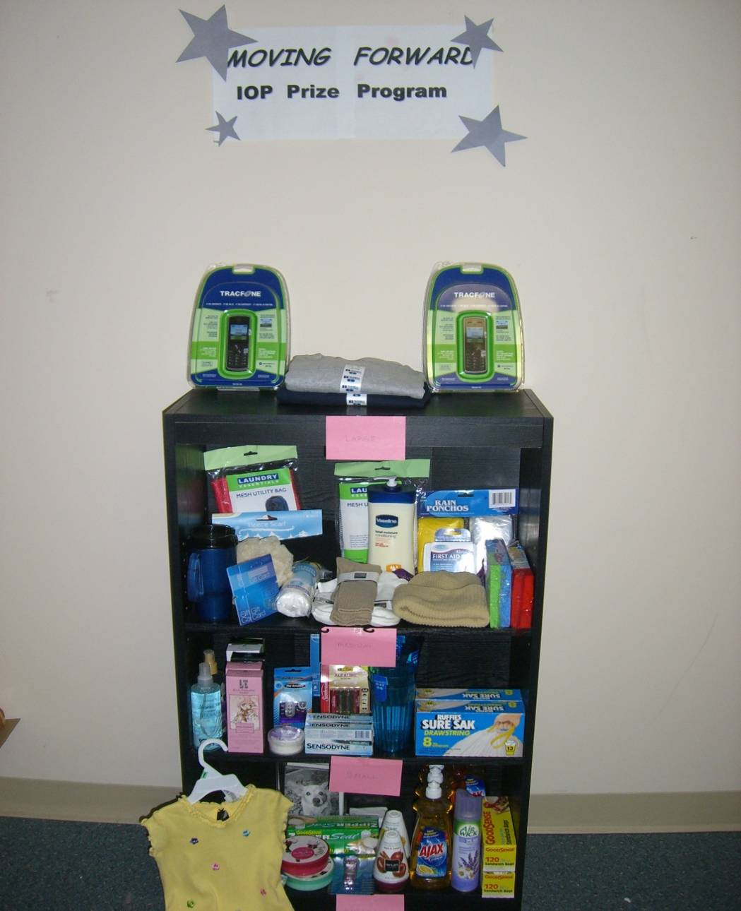
Looking Into the Future
Peace, Prosperity and…
Prizes in every clinic!

